Slide 1
HEART DISEASE PREDICTION
BY:
A.VAMSHI KRISHNA
P.VIVEK REDDY

Slide 2
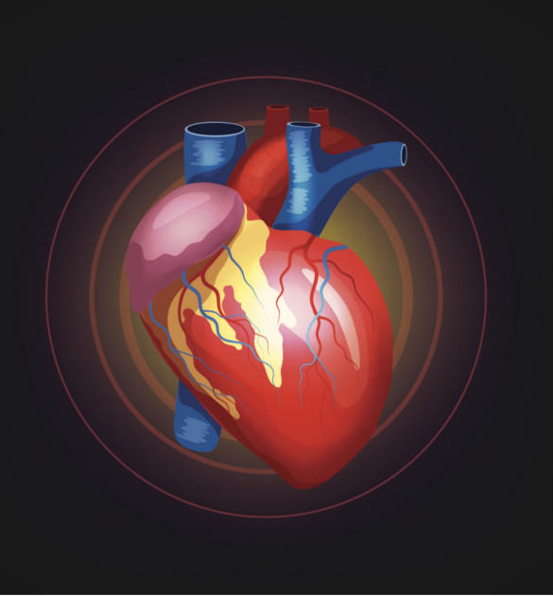
Table of contents
Introduction
Purpose of project
Existing System
Proposed System
Problem Definition
Software & Hardware Requirements
Architecture
Results
Conclusion
Bibliography

Slide 3
introduction
Machine learning in conjunction with big data can not only collect information but also find specific patterns. In recent times, heart disease prediction is one of the most complicated tasks in medical field. In the modern era, approximately one person dies per minute due to heart Stroke. Machine Learning plays a crucial role in processing huge amount of data in the field of healthcare. As heart stroke prediction is a complex task, there is a need to automate the prediction process to avoid risks associated with it and alert the patient well in advance. This model makes use of heart disease dataset. The proposed work predicts the chances of Heart Disease and classifies patient's risk level by implementing different data mining techniques such as Logistic Regression, SVM, KNN, Decision Tree and Random Forest. The trial results verify that Random Forest algorithm has achieved the highest accuracy of compared to other ML algorithms implemented when 14 attributes are considered and some algorithms like svm, decision tree achieved same accuracy even by dropping some attributes. The aim of this system is to provide a quick, immediate and easy way to predict accurately.

Slide 4
PURPOSE OF PROJECT
Here the purpose of this project is to train and test the data to Predict whether there is a chance for a person of getting a heart disease or not. In this project we are going to predict the heart disease data by using some machine learning algorithms. They are Decision Tree, KNN, Logistic Regression, SVM and Random Forest algorithms.

Slide 5
EXISTING SYSTEM
Patients first apply for a doctor appointment after that the doctor validates the patient health status. However, doing this manually takes a lot of time because the patient needs to undergo various tests and wait until the reports arrive. Many different predicting systems are available but they make use of dataset and predict the result by taking the input parameters Lot of work has been carried out to predict heart disease using UCI Machine Learning dataset. Different levels of accuracy have been attained using various data mining techniques . But good accuracy is not achieved.
LIMITATIONS OF EXISTING SYSTEM
Accuracy is not better
Lack in providing good results and user friendly interface.
Incorrect Classification results.

Slide 6
PROPOSED SYSTEM
The primary goal of this project is to extract patterns from a common heart disease data set, and then build a model based on these extracted patterns, in order to predict the likely of getting heart disease by using classification data mining algorithms. Firstly data is collected and then data preprocessing is done and later data is split into train data and test data. Using train data the different type of Machine Learning models are trained and accuracy is predicted as a result and Plotting a graph. The objective of this study is to effectively predict if the patient suffers from heart disease. The data is fed into model which predicts the probability of having heart disease.
ADVANTAGES OF THE PROPOSED SYSTEM
User friendly interface
Efficient and Accurate.
Very helpful in predicting based on given inputs.
High Performance
Even though by dropping some attributes same accuracy has been achieved using some algorithms.

Slide 7
Problem definition
The project is heart disease prediction using various machine learning algorithms. The data can be collected from various sources. First we have to take data set from health sectors, hospitals which has various details about the heart patients such as such as patient personal details. Patients first apply for a doctor appointment after that the doctor validates the patient health status. However doing this manually takes a lot of time because the patient needs to undergo various tests and wait until the reports arrive. Hence it wants to automate the heart disease prediction(real time) based on patient information.
So the final thing is to identify the persons that are possible for being attacked by a heart disease. The solution is that this model is developed to predict well in advance to avoid risk and help patient taking suitable measures by consulting a doctor.

Slide 8
SOFTWARE AND HARDWARE REQUIREMENTS
Software Requirements specifies the logical characteristics of each interface and software components of the system. The following are some software requirements,
      Operating system : Windows 8, 10.
      Languages : Python, flask, machine learning.
      IDE : Visual studio.
Hardware interfaces specify the logical characteristics of each interface between the software product and the hardware components of the system. The following are some hardware requirements.
Processor : intel i3 or above.
Hard disk : 16GB and above.
RAM : 4GB and above.

Slide 9
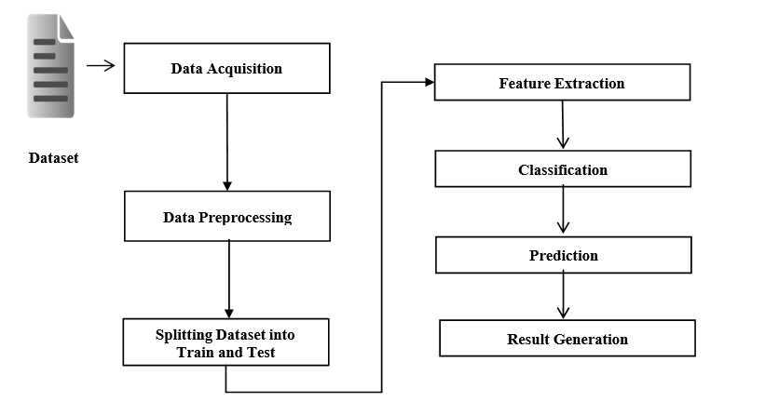
ARCHITECTURE

Slide 10
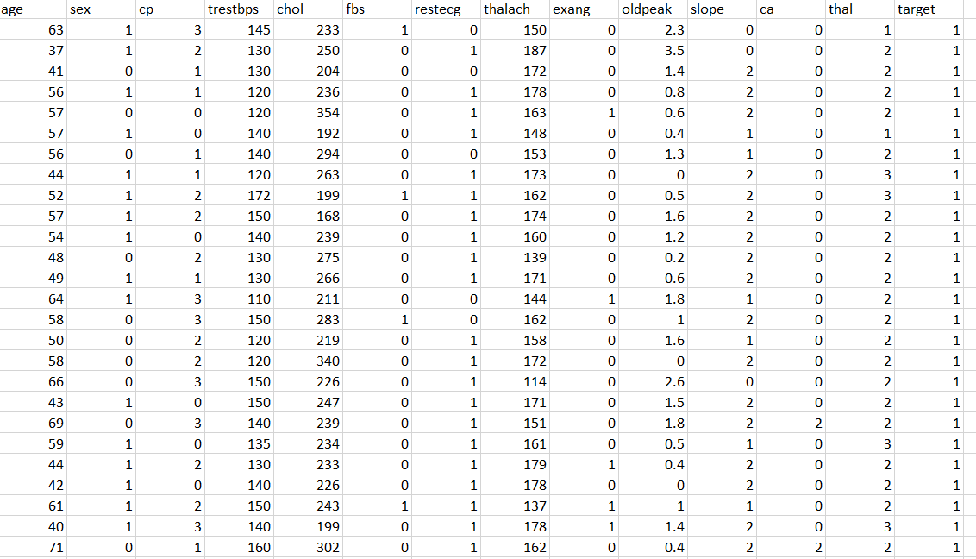
dataset

Slide 11
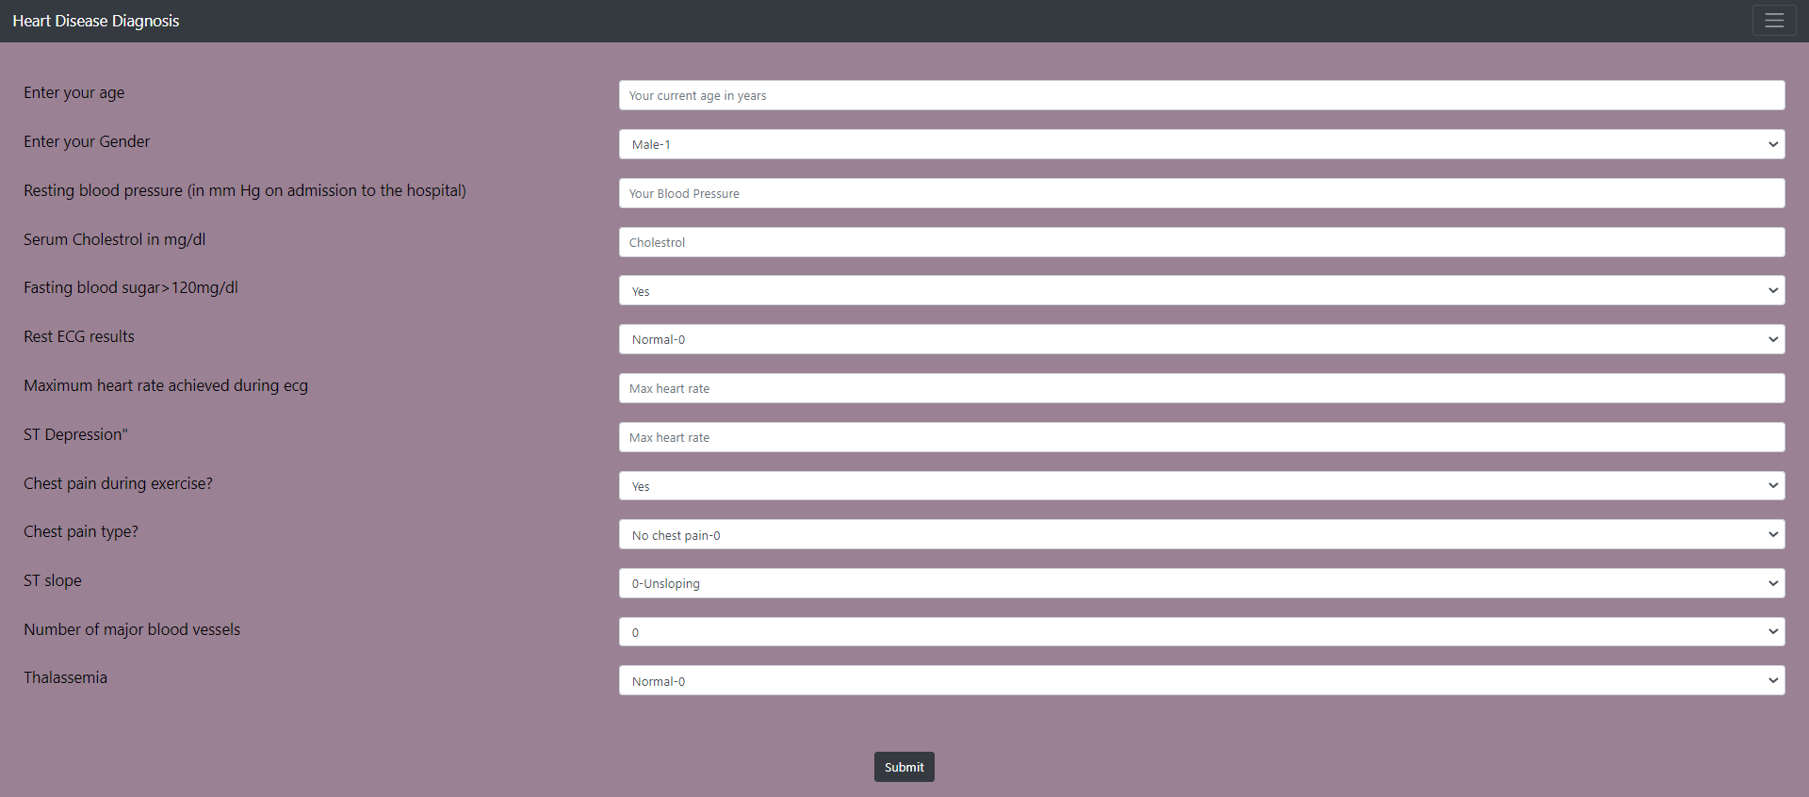
results
Webpage for Entering input data

Slide 12
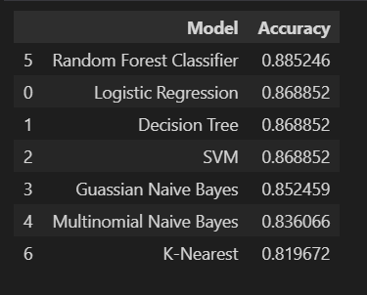
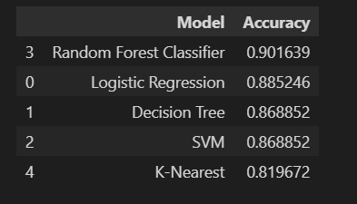
ACCURACY OBTAINED
Accuracy with 13 attributes.
Accuracy with 8 attributes.

Slide 13
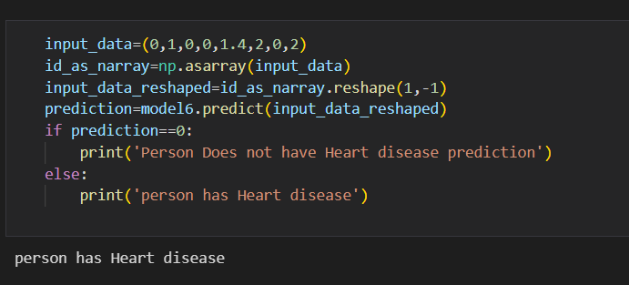
Testing of input data

Slide 14
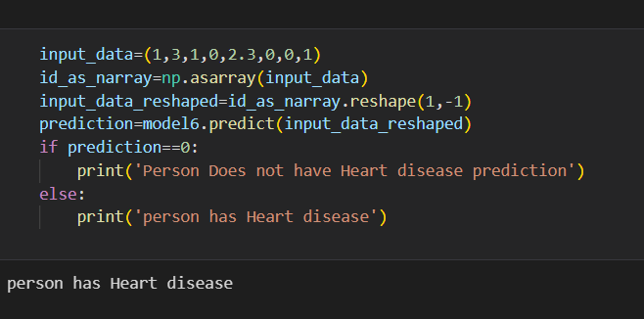
testing

Slide 15
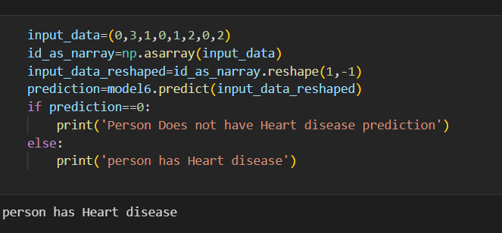
testing

Slide 16
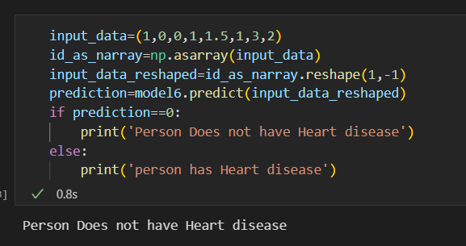
testing

Slide 17
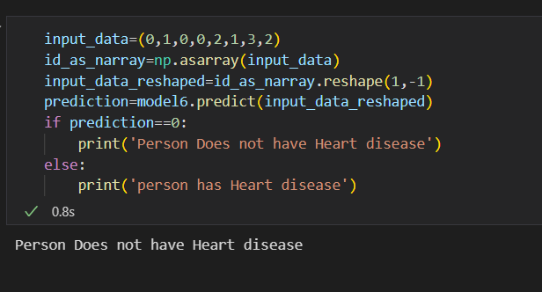
testing

Slide 18
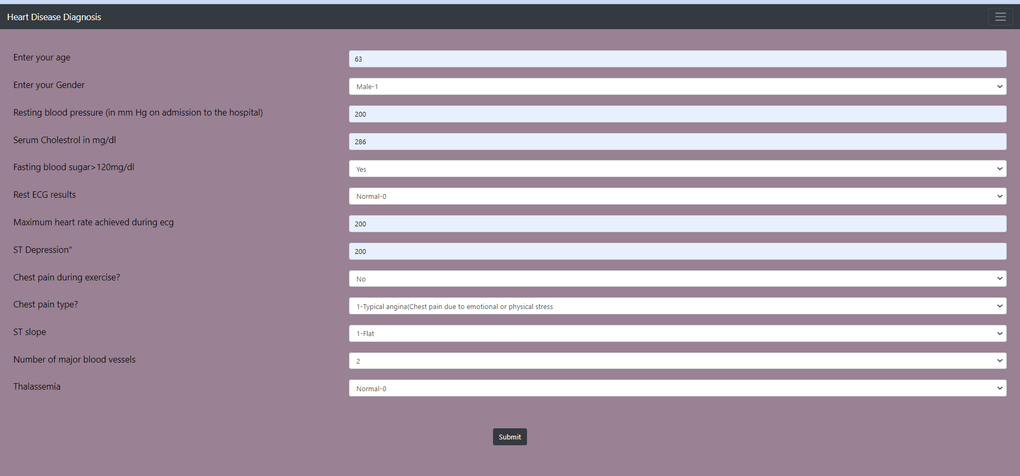
Testing in webpage

Slide 19
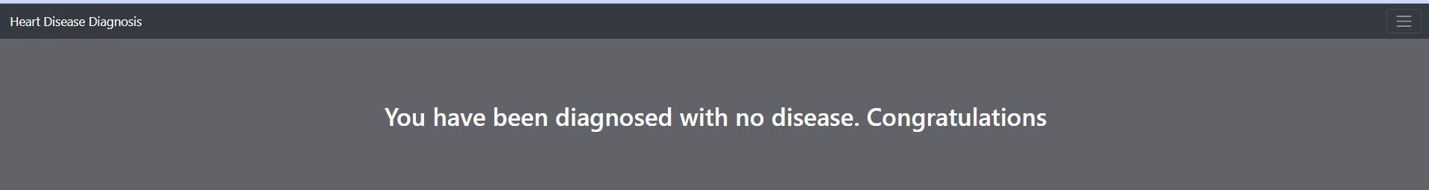
testing
Result for the data entered in previous slide.

Slide 20
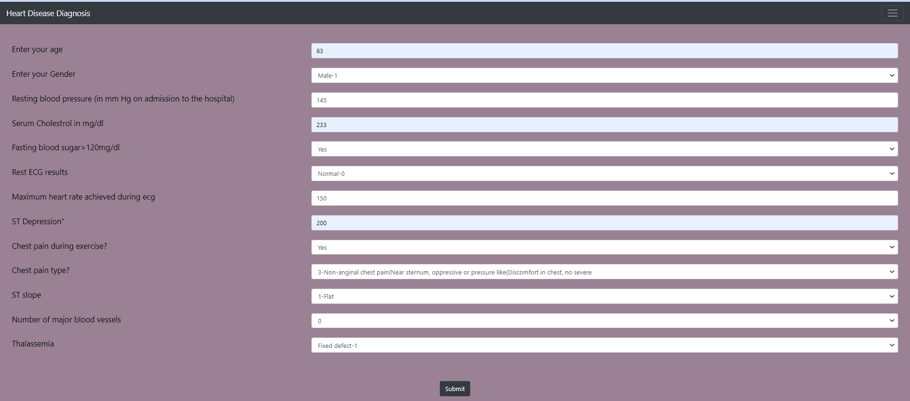
testing

Slide 21
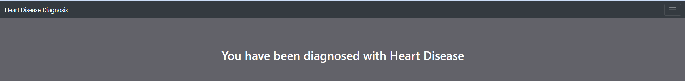
testing
Result for the data entered in previous slide.

Slide 22
conclusion
The machine learning field is continuously evolving. And along with evolution comes a rise in demand and importance. There is one crucial reason why data scientists need machine learning, and that is: ‘High-value predictions that can guide better decisions and smart actions in real-time without human intervention.’
The proposed model is GUI based, scalable, user-friendly, reliable and expandable system. The proposed project can also help in reducing treatment costs by providing initial diagnosis in time. This project can also serve as a purpose for training medical students and will be a soft diagnostic tool available for physician and cardiologist. General physicians can utilize this tool for initial diagnosis of cardio patients. With the increasing number of deaths due to heart disease, it has become mandatory to develop a system to predict heart stroke effectively and accurately. The motivation for the study was to find the most efficient ML algorithm for detection of heart disease. The result of this study indicates that the Random Forest algorithm is the most efficient algorithm with accuracy score of 91% for prediction of heart disease. In future the work can be enhanced by developing a web application based on the Random Forest algorithm as well as using a larger dataset as compared to the one used in this analysis which will help to provide better results and help health professionals in predicting the heart disease effectively and efficiently.

Slide 23
bibliography
P. Govindarajan, R. K. Soundarapandian, A. H. Gandomi, R. Patan, P. Jayaraman, and R. Manikandan, “Classification of heart stroke disease using machine learning algorithms,” Neural Computing and Applications, vol. 32, no. 3, pp. 817–828, Feb. 2020.
https://youtu.be/qmqCYC-MBQo
https://www.flask.com
https://www.machinelearningexpert.com
https://www.kaggle.com

